Slide 1
Altruism
Ali Abbas
Bsef19a525

Slide 2
ALTRUISM
Altruism is the unselfish concern to help others without expecting them to help you back.
Altruism is when we act to promote someone else's welfare, even at a risk or cost to ourselves.
Altruism is an alternative approach to having an egoistic or selfish mindset.

Slide 3
Who Popularized It?
Now let’s talk about who popularized(publicize) this term?
The word "altruism" was popularized (and possibly coined) by the French philosopher August Comte in French, as altruism which means “other people” or “somebody else”.

Slide 4
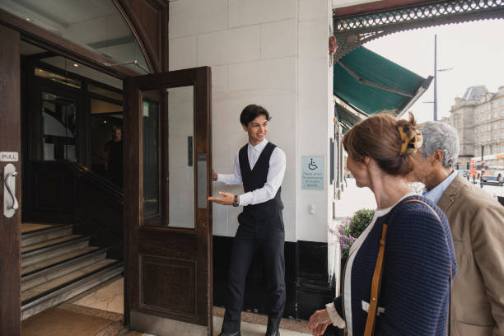
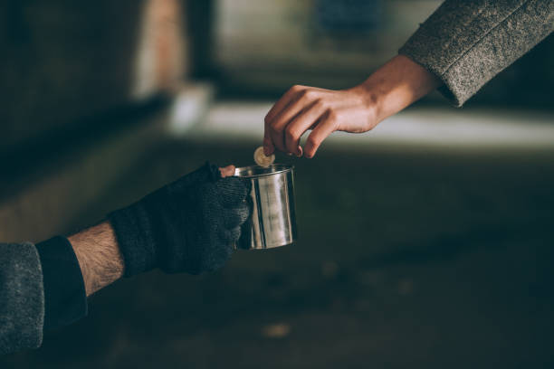
Daily life examples
From holding the door for someone to giving money to the people in need.
From holding someone’s weight (bag, bottle, luggage) to dive in order to help that person who was drowning in the icy river.

Slide 5
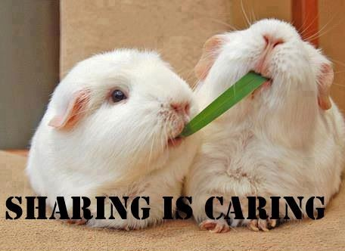
Daily life examples
Sharing someone resources despite of shortage, altruism speaks.
Similarly, Giving someone a good piece of opinion/advice that will be beneficial for him/her.

Slide 6
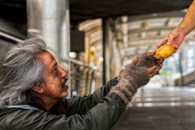
Daily life examples
Giving your lunch away to someone who was hungry at cost of being hungry yourself, is also altruism.
volunteering at a soup kitchen.
(These are some of the daily life examples)

Slide 7
Perspectives
Psychological
Biological
Islamic
Now let’s discuss these one by one

Slide 8
psychological
The International Encyclopedia of the Social Sciences defines psychological altruism as:
“A motivational state with the goal of increasing another's welfare”
Research has found that people are most likely to help if they recognize that a person is in need and feel personal responsibility for reducing the person's distress.

Slide 9
BIOLOGICAL
Steinberg (American university professor of psychology) suggests a definition for altruism in the clinical setting that is
"intentional and voluntary actions that aim to enhance the welfare of another person in the absence of any quid pro quo(exchange)external rewards".

Slide 10
ISLAMIC
In Islam, the concept "īthār" (إيثار ) is the basically notion of
“Preferring others to oneself".
Forgetfulness of one’s own concern.
Constant concern for ALLAH SUBHANA-HU-WATA`ALLAH.
Careful attitude towards people, animal etc.

Slide 11
Impact of Altruism?
Helping others feels good
The more you do for others, the more you do for yourself.
It tends to make us more active and ready to help others anytime.
It brings mental satisfaction.

Slide 12
THEORIES
Muhammad Talha Masood Bsef19a540

Slide 13

Altruism Is A Prosocial Act
An act in which our goal or our intent is to benefit others.

Slide 14
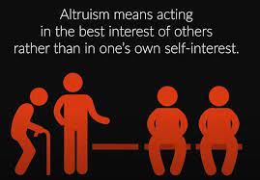
Major Types
Biological altruism
Psychological altruism
Reciprocal altruism

Slide 15

Biological Altruism
Kin Selection Theory
Kin Selection proposed by Hamilton, by this theory, protecting oneself and one’s relatives is a basic interest.
Example

Slide 16
Activity Time

Slide 17
Psychological Altruism
Danial Batson Theory
Negative state relief model

Slide 18
Daniel Batson Theory
This theory says that people can be genuinely altruistic and they have a natural compassion for one another.

Slide 19

Negative State Relief Model
Behaving altruistically can produce
positive emotions and diminish
negative ones for them.

Slide 20
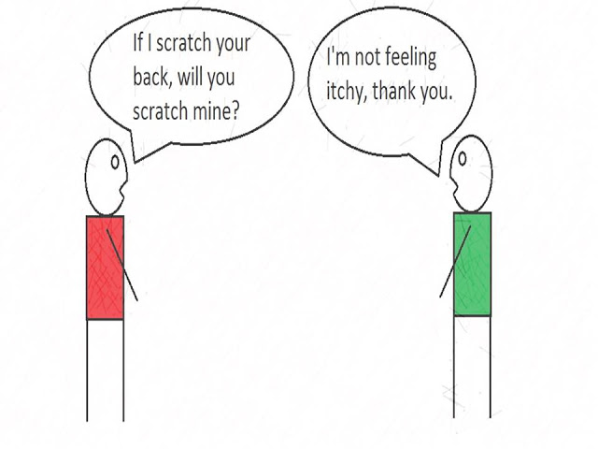
Reciprocal Altruism
Beneficial acts for non-relatives that are later repaid by beneficiary

Slide 21
Reasoning
Talha Tariq : Bsef19a544

Slide 22
Kin Selection Theory
Help those, who’re your genetic based relatives
Accepted by majority of community.

Slide 23
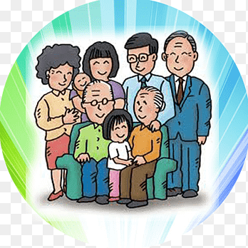
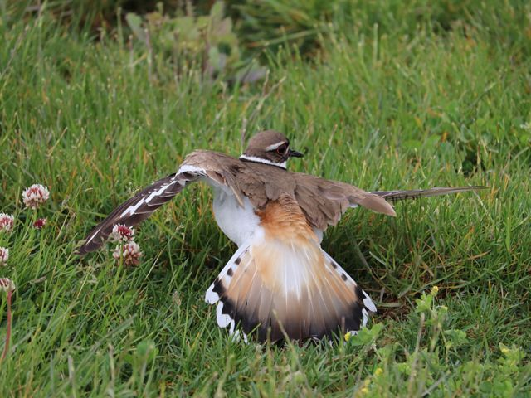
Mother Birds
Families

Slide 24
It’s Question Time.

Slide 25
RECIPROCAL Altruism
Expecting some benefit in return

Slide 26
Charity
(Reciprocal)
Save yourself from Hell-fire even by giving half a date-fruit in charity. (Bukhari)
مَّن ذَا ٱلَّذِى يُقْرِضُ ٱللَّهَ قَرْضًا حَسَنًا فَيُضَـٰعِفَهُۥ لَهُۥٓ أَضْعَافًا كَثِيرَةً
(Quran, 2:245)

Slide 27

Helping Mate
(Reciprocal)

Slide 28

Not everybody is snake 🐍

Slide 29

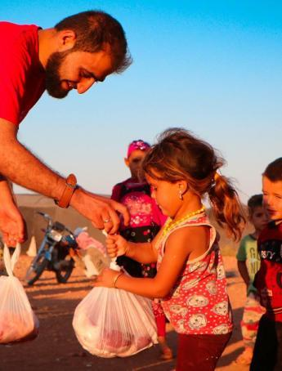
Batson Theory
Empathy model. Natural empathy
Charity
Blood Donations
Helping Mates

Slide 30
Negative State Relief Model

Slide 31
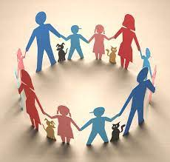

Help Chain
If someone, did you a favor—something big, something you couldn’t do
on your own—and instead of paying it back, you paid it forward to
three people … And then the next day, they each paid it forward to three
more … And the day after that, those 27 people each paid it forward to another three … And each day everyone in turn paid it forward to three more people … In two weeks, that comes to 4,782,969 people.

Slide 32

Pay it forward
Author:
Catherine Ryan Hyde

Slide 33
Story Time

Slide 34
Why accepted?

Slide 35
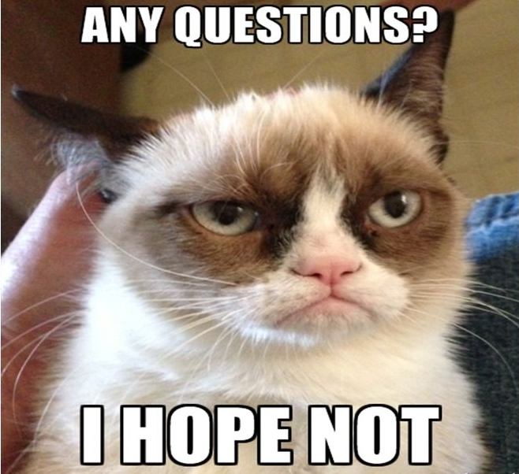

Slide 36
Importance
Abu Hurairah
Bsef19a545

Slide 37
Importance Of altruism
Altruism brings more meaning to our lives. When we see people helping each other, it inspires us to do the same. It reminds us that we’re not alone.

Slide 38
Importance Of altruism
It is essential to have altruism in our lives so that our community can thrive and succeed as a whole. Without altruism, a community does not prosper together. This lack of altruistic efforts towards a better community will result in a selfish society spiraling into disaster. Here are some other reasons, why altruism is important?

Slide 39
How Altruism in Society is Important?
There’s no one in the society who can achieve some thing bigger individually. Human Beings are dependent on each other, by nature, in order to survive. In this modern world of selfishness no one cares about others. Every person in this world is trying to get fame even the society may be ruined, he/she won't care about it. In order to overcome these things, we have to be more cooperative, altruistic, compassionate, and trustworthy to make an Altruistic society.

Slide 40


Slide 41
How Altruism in Leadership is Important?
If an organization is comprised of people who are selfish and leg-pullers then that organization will never succeed because a one-man can never do all the things individually. In this situation, a leader can do a lot of things in order to boost up his employees and make them united by his altruistic behavior.
Let’s take a look at four ways altruism can be beneficial at work for both the employees and the company.

Slide 42
How Altruism in Leadership is Important?
It contributes to employee well-being:
One study on altruism at work found that helping colleagues makes people happier. Since giving back is rewarding in itself, helping others can lead to a greater sense of purpose at work and higher levels of job satisfaction. Not only that, but the so-called “helper’s high” produced by performing altruistic acts can even help reduce stress.

Slide 43
How Altruism in Leadership is Important?
It helps motivate employees
Altruism can be a motivating factor at work. When employees feel that their work matters and they are helping others in some way, it boosts their motivation levels. People need intrinsic motivation just as much as external rewards, such as money or recognition. The human drive to help others is innate to all of us. Finding ways to incorporate it into our daily work helps us stay motivated by connecting to something greater than ourselves.

Slide 44
How Altruism in Leadership is Important?
It creates an altruistic company culture
If you’re a leader who wants to create an altruistic company culture, it’s best to start with yourself. People who benefit from the altruistic behavior of others are more likely to model that behavior and pay it forward by helping others. Let's say you let a team member leave early due to a family emergency. They are then more likely to be flexible the next time a colleague or customer has a request for them. Had you denied their request, they would have been less willing to help others.

Slide 45
How Altruism in Leadership is Important?
It increases productivity
Employees who are happy and motivated and feel well cared for by their organization are naturally more productive. They are less prone to absenteeism and more likely to stay late to get work done, resulting in lower costs and productivity gains for the company. Happy, healthy employees are also more likely to stay where they are. On the other hand, a company that fails to act altruistically toward its employees is likely to experience high employee turnover.

Slide 46
Altruism in the light of Islam

Slide 47
That’s All!

Slide 48
Modernism & Implementation
Muhammad Abdullah
Bsef19a529

Slide 49

At which stage we are actually Present?

Slide 50

Present condition
Today as we see everyone in this era of the modern world is busy with his own tasks and duties without paying attention to others including his/her own family. This creates isolation between our beloved relationships with our family and friends. Everyone in this world is becoming selfish and thinking about their own selves. This type of behaviorism destroys the whole society and it’ll never succeed as there’s no trust, there’s no will to help others, there’s nothing productive.

Slide 51


Present condition
Another aspect is excessive use of social media makes us lazy, useless, and worthless. Social media is made for positive use but the misuse of social media made society selfish. If someone is seeking help or support from us but we are making fun of him while we have to help him as this is our moral duty.

Slide 52

Implementation
So, we have to work on this selfishness by achieving an altruistic behavior in order to get success and become an honorable person. Here are some ways to implement concept of altruism in the people, living in modern era.

Slide 53


Implementation
BE A ROLE MODEL
Be a role model by helping others at work, in day-to-day life, and online. Help a coworker carry equipment, bake cookies for a new neighbor, and leave uplifting comments on social media. Consistently modeling altruism is one of the most influential ways to encourage it in others — especially kids.

Slide 54

Implementation
SHARE REAL STORIES
Get donations and volunteers for important causes by putting a face to a name and sharing real stories. Raising money for women in business. Share a touching story about how financial aid helped a single mom create a successful business.

Slide 55

Acceptance
PROMOTE ACCEPTANCE
People are more likely to help members in their personal circles. Encouraging the people around you to be more inclusive is vital to promoting altruism. Encourage others to bring new friends to gatherings. Share your thoughts on social platforms.

Slide 56

Implementation
CREATE A SUPPORTIVE COMMUNITY
One of the best ways to promote altruism is by creating an outlet for people to give. Building a supportive community is a great way to do that.

Slide 57
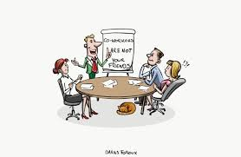

Implementation
GET YOUR COWORKERS INVOLVED
Bring altruism to the workplace by supporting specific causes and creating an environment of mutual aid.

Slide 58
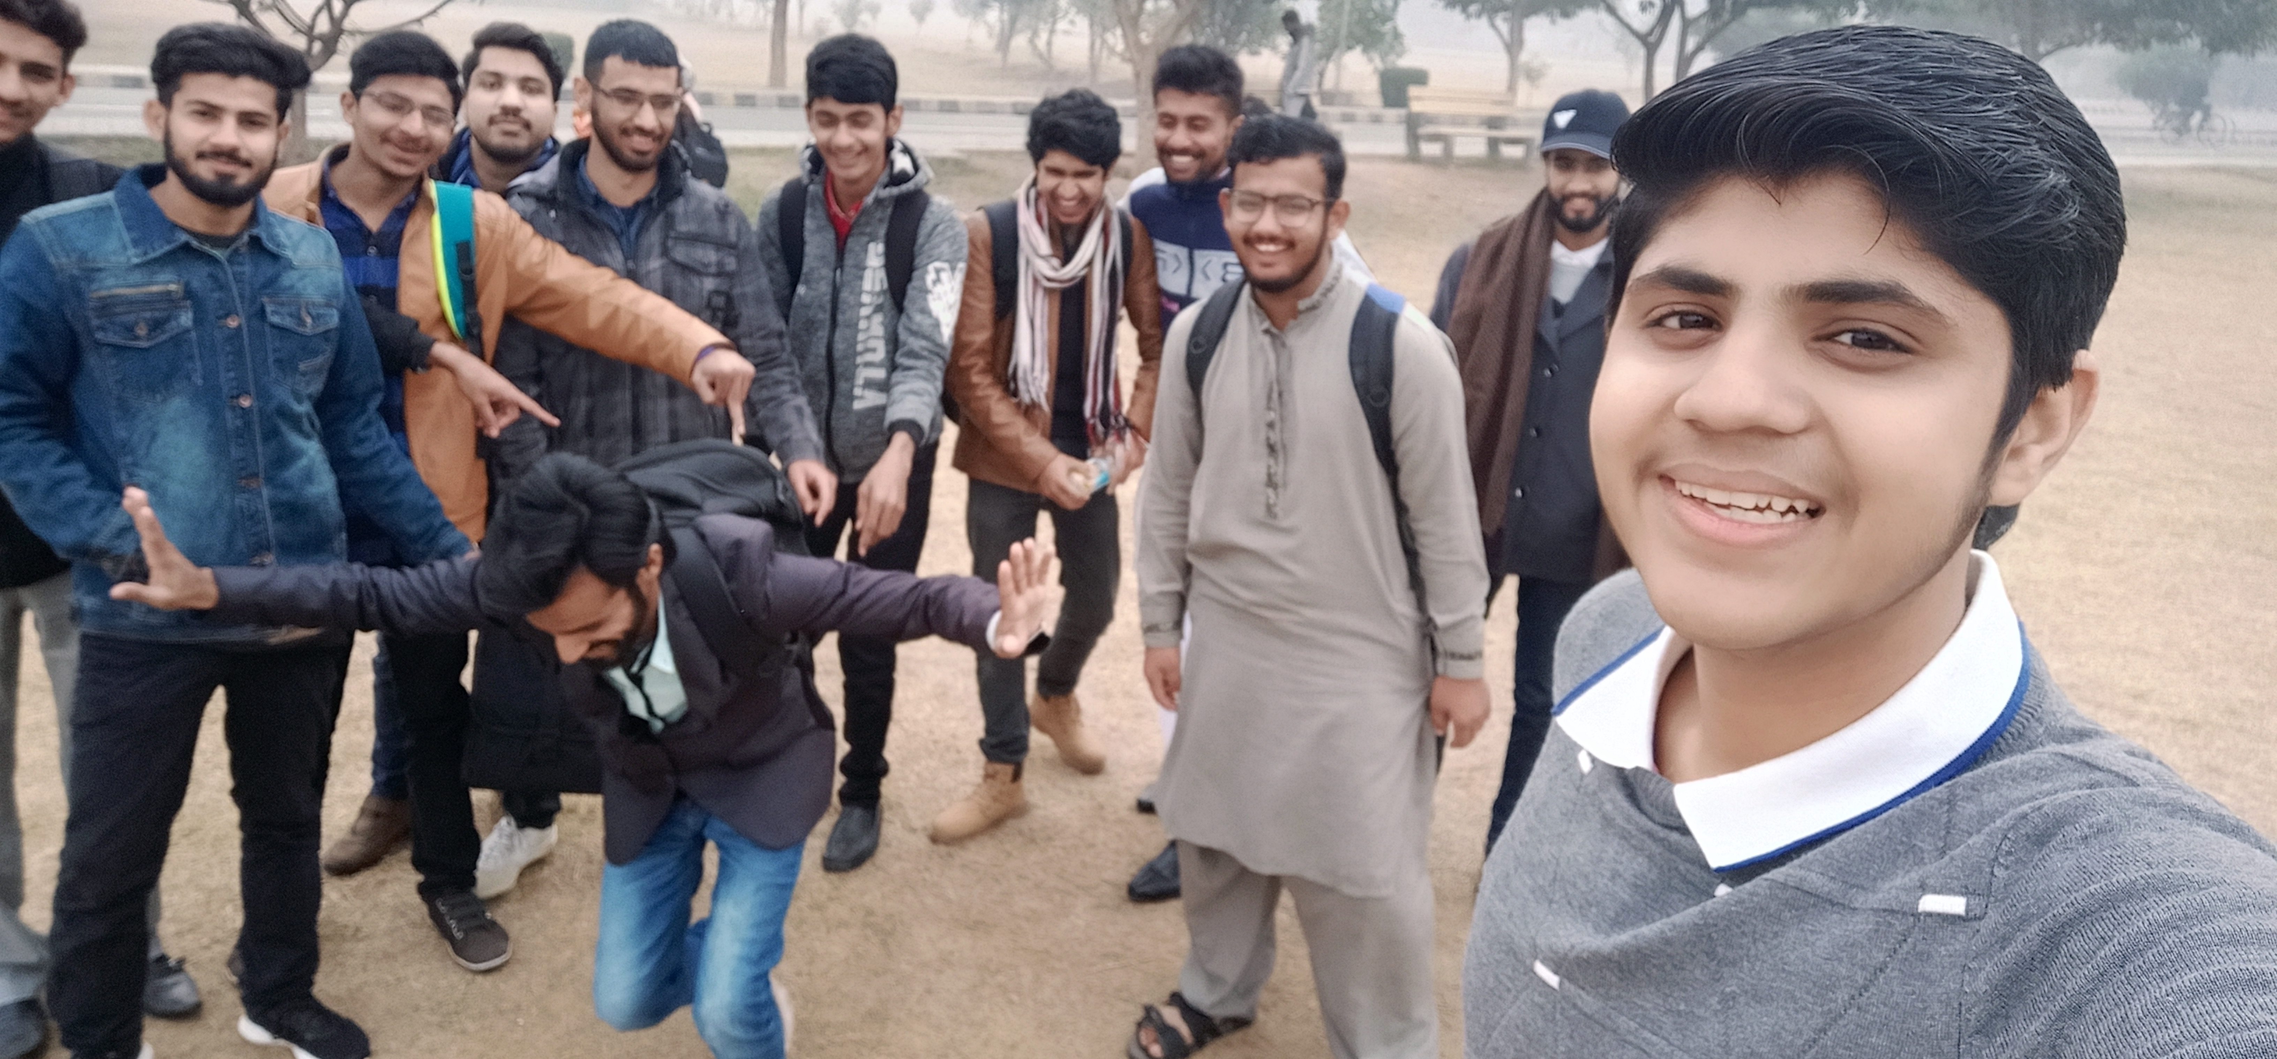
Implementation
SPEND QUALITY TIME WITH OTHERS
Whether you attend a community event, accept an invitation from a friend, or host a weekly get-together, you can give to others by sharing the gift of your company. Your time can be a valuable asset, and spending quality time with the people in your life is one of the most generous gifts you can give — not only for them but for ourselves, too.
“Caring about the happiness of others, we find our own.”

Slide 59


Implementation
GIVE SINCERE COMPLIMENTS
Each person has unique qualities they bring to the table. If you acknowledge an intrinsic part of someone’s identity, like a personality trait, or an aspect of their character that you admire, you may just make that person’s day.
“Kind words can be short and easy to speak, but their echoes are truly endless.”

Slide 60

Conclusion
We have to adopt and bring altruism in our life because after all we are all social animals according to Aristotle. We need each other in time of distress. We can’t survive in this world without help of each other. And my message to all of you is that instead of being egoistic, try to bring kindness and passion for helping others. It will nourish your soul and gives you internal satisfaction and bliss.

Slide 61
That’s All! Thank you

